Slide 1
“Super Twiggit to the Rescue”
2007 ANIMATION STORYBOARD
Team 179
Children of the Swamp

Slide 2
Table of Contents
Baseline Storyboard
Team 179 Animation Process
Student’s Personal Storyboards
Storyboard + Dialog (Shortened Version)
Credits

Slide 3
Baseline Storyboard
Factory on
River Dumping
Waste
Superhero
Enters
Scene
Superhero
questions
dumping
Superhero
Goes back
in time
Superhero
Zaps
problems
Cleaned up
Scene is
beautiful

Slide 4
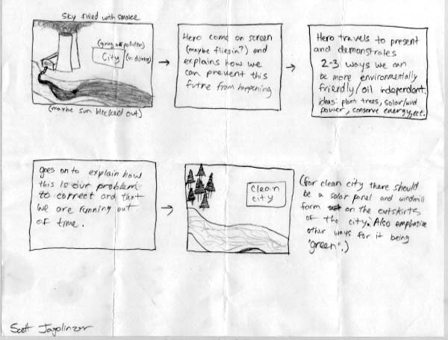
Student’s Personal Storyboards

Slide 5
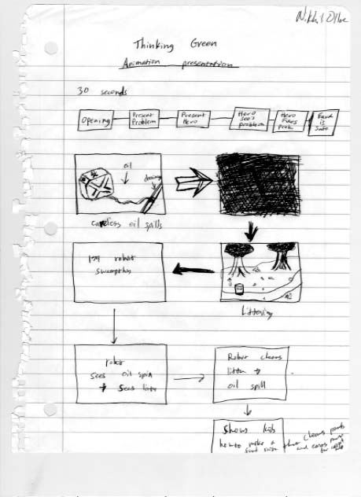
Student’s Personal Storyboards Cont.

Slide 6
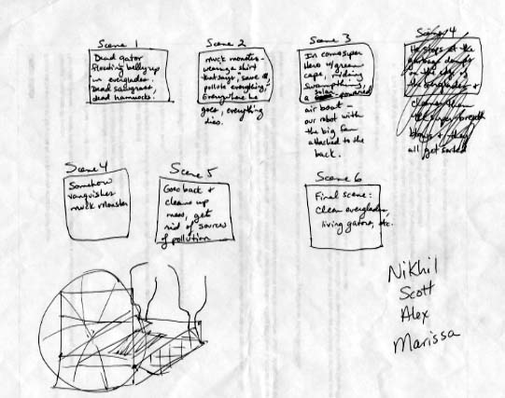
Student’s Personal Storyboards Cont.

Slide 7
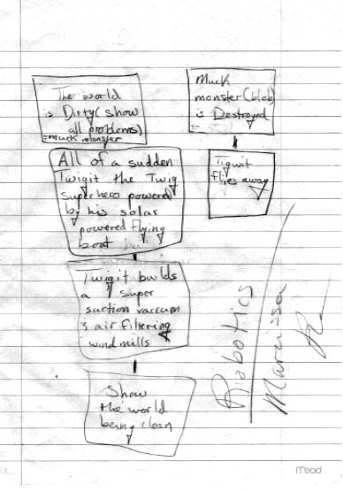
Student’s Personal Storyboards Cont.

Slide 8
Team 179 Animation Process
Team brainstorms ideas based on theme and Autodesk options.Team is
encouraged to take ideas home and thhink of additional ideas and come
back with their own storyboards.
Students present their own storyboards to the Team. Team chooses favorite
Ideas from multiple storyboards. Ideas that are to be used are written down.
Baseline storyboard is created from written down ideas.
Baseline storyboard is divided into scene segments.
Animators and Mentors decide which segments each animator will work on.
Segments are reviewed and revised.
Dialog is created based on storyboard and segments.
Segments are continued to be reviewed and revised.

Slide 9
Team 179 Animation Process (continued)
Dialog is performed by students in taping sessions.
Segments are continued to be reviewed and revised.
Music is created and performed in taping sessions.
Segments are reviewed and revised.
Title Page and Credits are created.
Segments are finalized and rendered.
Segments are connected to create animation.
Dialogue is added to the attached segments.
Music is added to animation.
Title Page and Credits are added to animation.
Animation is saved as per filename specification.
Animation is Uploaded.

Slide 10
Scene 1
Final Storyboard + Dialog (Shortened Version)
VISUAL:
A factory with stacks polluting the air in the foreground, city is off to the right rear.
A river that runs past the factory – dark water. A small run-off pipe going from the factory to the riverbank.
Dying trees, dead animal (gator floating upside down) in the river.
Something showing the year 2027.
An off-limits sign due to hazardous water conditions.

Slide 11
Scene 1 (cont.)
SCRIPT:
(Cue the background music)
Narrator: In the near future, Year 2027, Super Twiggit is patrolling a new area to find environmental disasters, when he comes upon this scene.
Super Twiggit: Aarrgghhh! This is terrible!
I must go back and fix it!

Slide 12
Scene 2
VISUAL:
Super Twiggit Z-O-O-O-M-S on his airboat at super-speed to go back into the past in a swirling vortex.
(The past is our present-day).
Swampthing stops in the Year 2007.
SCRIPT:
(time-travel psycho sound effects with or without music)
Narrator: He rides the Super Swampthing back in time to the same spot in the year 2007.

Slide 13
Scene 3
VISUAL:
Super Twiggit stops at same location, with same factory, but the environment isn’t dead yet.
Could show just a few trees, kind of short, plus sick-looking gator. River could be a light brown.
Sign warning of possible hazards in water.
SCRIPT:
(continue background music)
Super Twiggit: Oh, good! I can still fix the problem before it’s too late!

Slide 14
Scene 3 (cont.)
SCRIPT:
(continue background music)
Narrator: Super Twiggit activates his solar-powered vaporizer on the Swampthing.
(zapping and exploding sound effects)
VISUAL:
Super Twiggit zaps the stacks (and possibly the pipe) to get rid of the problem from the factory.
(if time) He then lands next to factory and goes inside to teach them better ways.
SCRIPT:
(continue background music)
Super Twiggit: Problem is gone! (if time) I must show them the long-term solution!

Slide 15
Scene 4
SCRIPT:
(zooooming sound effects with or without music)
Narrator: His job is done! Super Twiggit goes back into the future, Year 2027.
VISUAL:
Super Twiggit Z-O-O-O-M-S on his airboat at super-speed to go back into the future in a swirling vortex.
Swampthing stops in the Year 2027.

Slide 16
Scene 5
VISUAL:
New and Improved Future Scene:
Same factory. Has big solar panels and wind mills all around it.
A river that runs past the factory – a clear-blue color. Pipe is gone.
Lots of taller trees, a gator, fish jumping out of water in the river..
A sign indicating the river is open for recreational activities of some kind.
SCRIPT:
(continue background music)
Super Twiggit: (if time) Aaahhhh…..that’s much better! It’s amazing what a little ingenuity can do.
Narrator: (if time) Super Twiggit rides away to come to the rescue another day!

Slide 17
CREDITS
ANIMATION TEAM:
Students
Nikhil Ollukaren
Scott Jagolinzer
Marissa Runkle
Alex Nicoleau
Mentors
Roy Bays
Paul Ollukaren
Mark Gross
Lydia Runkle
Carol Erenrich
ANIMATORS:
Nikhil Ollukaren
Scott Jagolinzer
VOICES:
Narrator
Marissa Runkle
Super Twiggit
Alex Nicoleau
GRAPHICS:
Marissa Runkle
Lydia Runkle
CREATIVE DIRECTOR:
Carol Erenrich
MUSIC:
Lydia Runkle

